Slide 1
Opinion Analysis of Media Bias
CS5344: Final Project Presentation
Team 42: Wu Tong, Yang Haohong

Slide 2
Content
Target Task
Dataset
Approach
Experiment & Result
Lesson Learned
Finding

Slide 3
Target task
Main Task: Sentiment Classification
Objective:
Analyze the sentiment and opinion.
Identify potential biases or consistent perspectives.
Uncover patterns in how Singapore-related news is portrayed internationally.

Slide 4
Dataset
Main Dataset: Global Geographic Graph Singapore (GGGSG) dataset
Description:
English news mentioning Singapore from Apr. 4, 2017 to Jul. 19, 2024.
Machine-annotated.
Support Dataset:
Large Movie Review Dataset
Financial Phrase Bank v.1.0
……

Slide 5
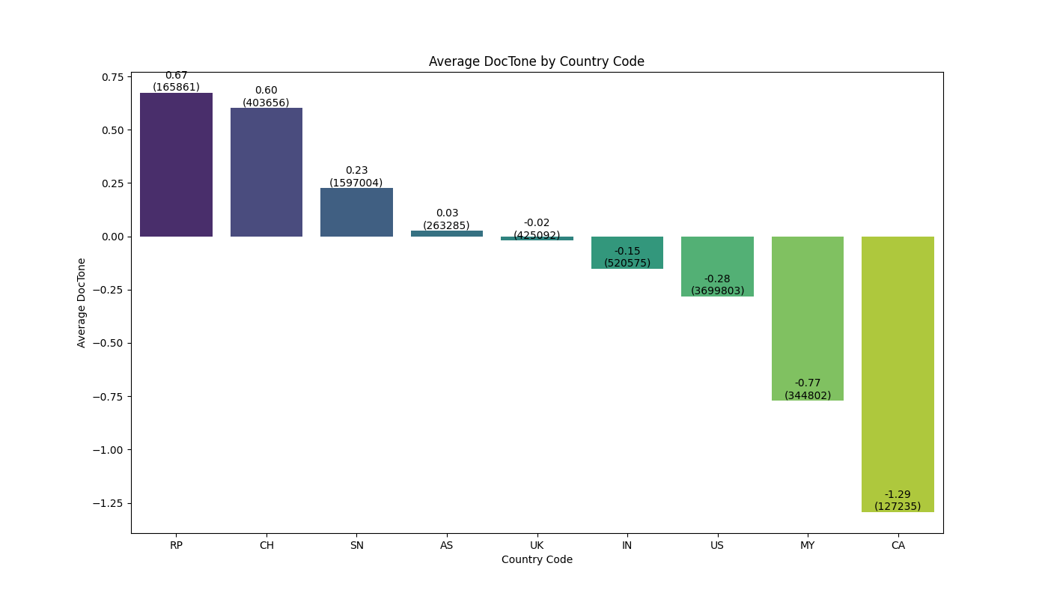
Media Bias Result
For those who report most frequently on news about Singapore:
News sources from RP (Philippines), CH (China), and SN (Singapore) are more likely to report positively on Singapore.
News sources from CA (Canada), MY (Malaysia), and US (United States) are more likely to report negatively on Singapore.

Slide 6
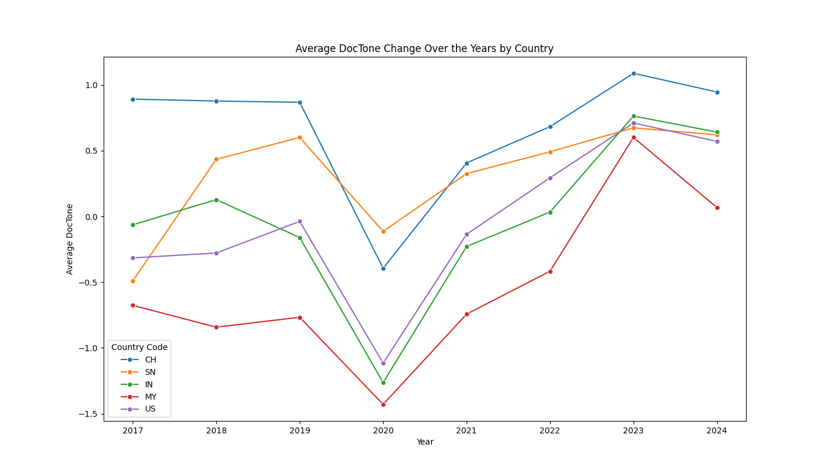
Media Bias Trend
All countries’ media show a drop in positive tone towards Singapore in 2020, with recovery starting from 2021.
China and Singapore's media are more positive, while US/MY/IN media are not so positive. All countries show a dip in 2020 but recover afterward.
Likely due to COVID-19’s impact on Singapore’s economy, tourism, and regional tensions, leading to more negative coverage.

Slide 7
Approach
Preprocessing source data and tokenization
Fine-tune RoBERTa
Feature Extraction
Train Random Forest with hyperparameter optimization
Evaluation

Slide 8
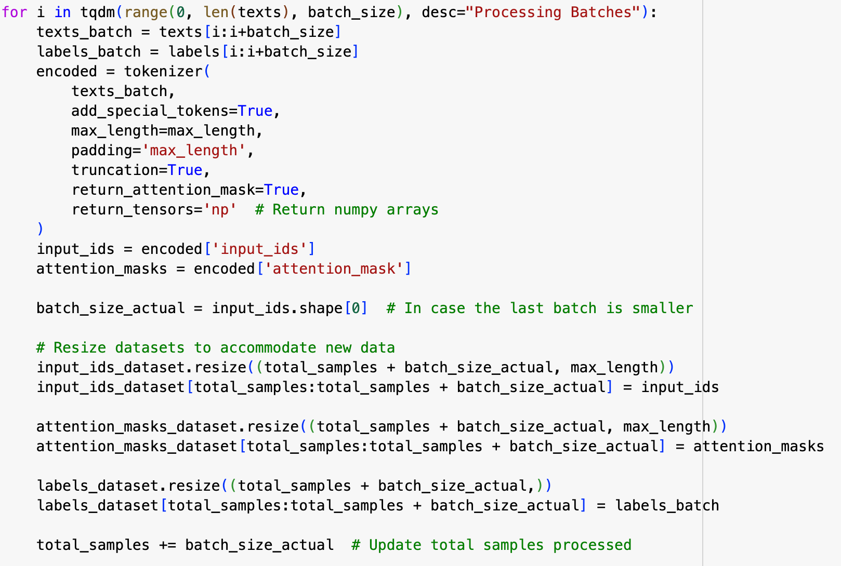
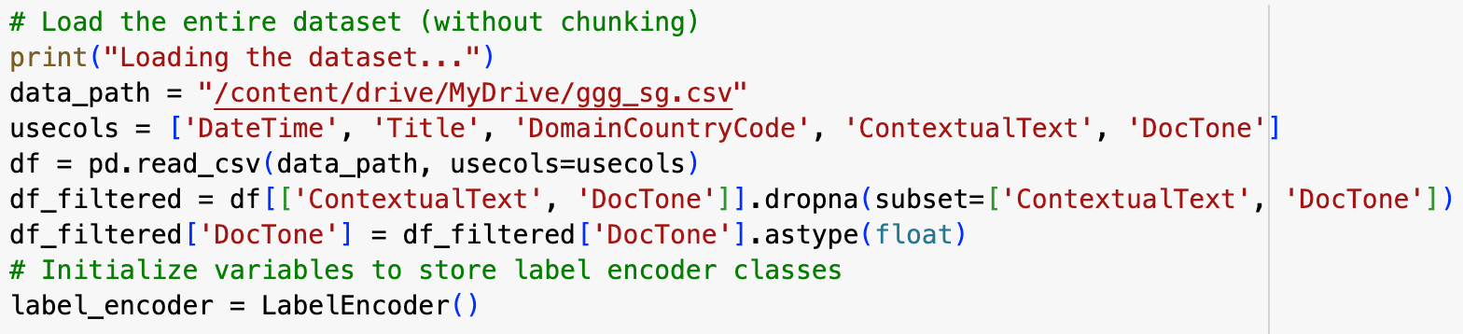
Preprocessing source data and tokenization
Read source data, do regular EDA process
Stream Processing with lazy evaluation: reduce memory usage
Drop irrelevant columns, filter out empty value
Add sentiment label based on DocTone column
Use 5 percentile ranges to divide sentiment into 5 levels
Tokenize the content into input_ids and attention_mask

Slide 9
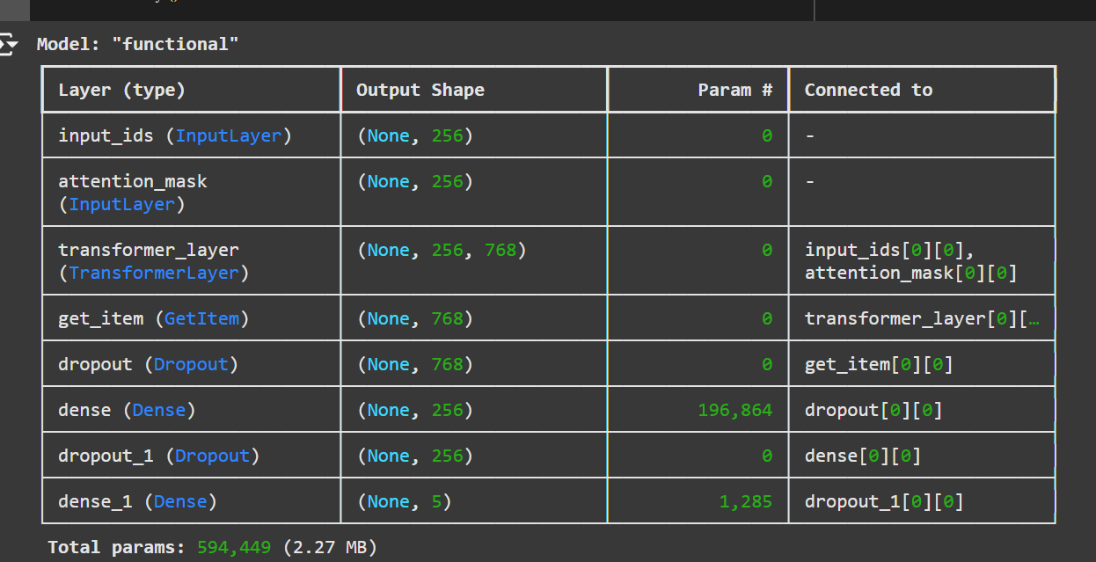
Fine-tune RoBERTa
Compute class weight dict
Build model
Define a custom Transformer Layer
Use Keras input layer to receive ids and attention mask
Create a transformer layer to extract content, select first token as the feature vector
Add Dropout and Dense Layer

Slide 10
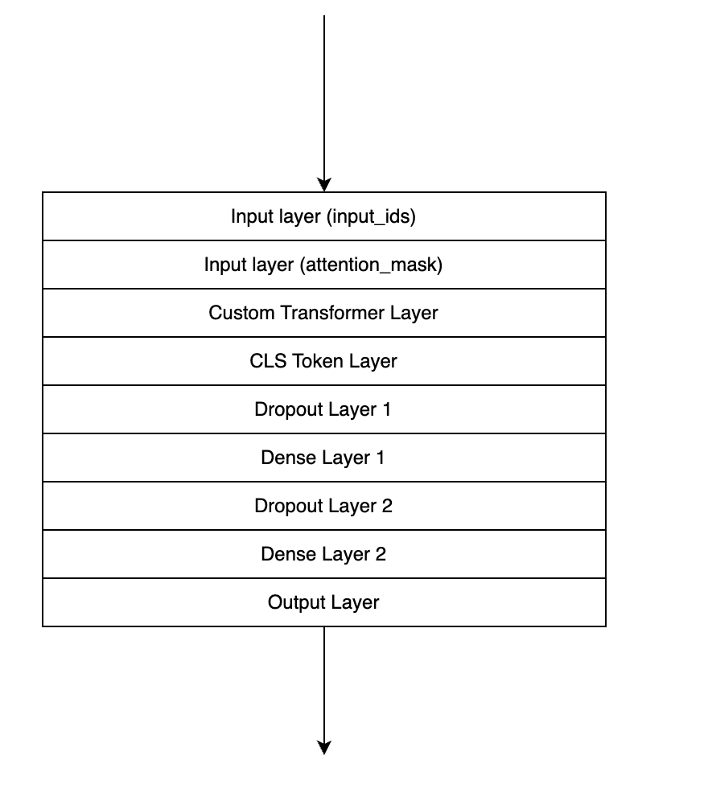
Fine-tune RoBERTa
3. Optimization:
Use Adam optimizer
Use mixed_precision.LossScaleOptimizer to scale the loss in a dynamic way to ensure stable values in mixed precision training.
Optimize hyperparameter by Optuna
Data generator (Python generator to fetch data in batch)

Slide 11
Feature Extraction and Train RF
Extract CLS token’s embedding from the fine-tuned RoBERTa model
Custom embedding extractor class
Receive input_ids and attention_mask
Rerturn CLS token embedding
Extract train and test dataset’s embedding
Split into 20 batches to reduce memory usage
Then we use the embedded data to train Random Forest model (with Optuna search for best hyperparameter)

Slide 12
Experiment (Baseline)
Class | Precision | Recall | F1-Score | Support
0(Negative) | 0.70 | 0.49 | 0.58 | 504
1(Neutral) | 0.63 | 0.72 | 0.67 | 989
2(Positive) | 0.61 | 0.63 | 0.62 | 506
Accuracy |  |  | 0.64 | 1999
Macro Avg | 0.65 | 0.61 | 0.62 | 1999
Weighted Avg | 0.64 | 0.64 | 0.63 | 1999
Baseline Approach:
TF-IDF + Logistic Regression
Accuracy: 0.64

Slide 13
Experiment
Class | Precision | Recall | F1-Score | Support
0 (Strong Negative) | 0.77 | 0.75 | 0.76 | 367429
1 (Negative) | 0.76 | 0.69 | 0.73 | 367394
2 (Neutral) | 0.72 | 0.71 | 0.71 | 367434
3 (Positive) | 0.86 | 0.88 | 0.87 | 367421
4 (Strong Positive) | 0.78 | 0.87 | 0.82 | 367383
Accuracy |  |  | 0.78 | 1837061
Macro Avg | 0.78 | 0.78 | 0.78 | 1837061
Weighted Avg | 0.78 | 0.78 | 0.78 | 1837061
100% data-load fine-tuned RoBERTa with Random Forest:
Accuracy=77.9%
Increase the accuracy of 15% compared with baseline model
Performance for positive is higher than negative

Slide 14
Experiment (Cross Validation)
IMDB Review Dataset
Accuracy = 63.18%
Different script aspect may cause the performance downgrade
Class | Precision | Recall | F1-Score | Support
0(Negative) | 0.62 | 0.70 | 0.65 | 12500
2(Positive) | 0.65 | 0.57 | 0.61 | 12500
Accuracy |  |  | 0.63 | 25000
Macro Avg | 0.63 | 0.63 | 0.63 | 25000
Weighted Avg | 0.63 | 0.63 | 0.63 | 25000

Slide 15
Lesson Learned
Large scale data processing
Need to use stream processing tools (Spark) to deal with big-data processing bottleneck.
For potential compatibility issue, can use chunk, data reading flow and data generator to fetch data on-demand.
Data & Model Scale and GPU Training Speed
Large model needs much more time to train, GPU cost will be expensive
For this project, we use 256 token length (13GB data) to train RoBERTa model, cost more than 40hours using single A100 GPU to train. 512 token length will have 30+GB data which needs 90+hours for training, 1024 token length is 70+ GB.

Slide 16
Inspiration
Different dataset means different aspects
In cross validation section we can see that model has wrose performance in different aspect dataset.
Different aspects has different emotional expressions. Movie review can be more complex, especially contains sarcasm, puns or ambiguous sentences. The model may not catch these expressions accordingly.
Expressions of negative and positive emotions
Negative emotions may be expressed using indirect and euphemistic language to maintain objectivity and neutrality.
Same as movie review, negative emotions may use parody, metaphor, analogies to deine something in indirect ways. For strong negative emotions, sometimes will use triple denial or other methods to reinforce the denial.

Slide 17
Thanks!

